Slide 1
Developing a Comprehensive Housing Assessment
WA State RCL Trainings March 2013
Martha Egan
The Coordinating Center

Slide 2
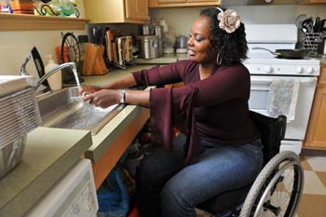
Presentation Objectives
Understanding the Intent and Value of Using a Housing Assessment
Guidance on how to develop a Housing Assessment
Intended Outcomes of Using a Housing Assessment

Slide 4
Housing Coordination Process
Housing
Connecting
Locating
Securing
Medical needs/Safety Needs
Social
Support
Financial
Personal History

Slide 5
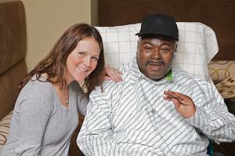
Person-Centered Housing Process
Preferences / Desires
Engagement / Trust / Rapport
Informed Choices
Independence
Strengths / Assets

Slide 6
What is a Housing Assessment?
A Housing Assessment is a person-centered process that encourages an individual to focus on strengths, assets and preferences when exploring community living options………

Slide 7
Housing Assessment Objective
The objective of a Housing Assessment is to obtain information, data, and knowledge about a person’s housing history and preferences in order to help a person achieve his/her community living goals………

Slide 8
Housing Assessment Focus
Identifying a person’s:
Strengths and assets
Challenges
Past housing history
Preferences
Needs
Community housing goals

Slide 9
Housing Assessment Components
Face to Face Meeting
Develop a trusting relationship
Initiate a dialogue about a person’s previous living arrangements
Discussion about successes and challenges and future community housing preferences
Developing Strategies
Recognizing and overcoming challenges
Determining preferences and needs
Achieving community living goals
Education and Information
Affordable housing options and opportunities
Information on obtaining documents
Understanding affordable housing program obligations

Slide 10
Housing Assessment Tools
Initial Housing Intake
An Initial Housing Intake is a tool (form) utilized during a face-to-face interview with a person to initiate a dialogue about a person’s previous living arrangement (s) prior to entering a nursing home/institution; to discuss and identify possible barriers to accessing affordable housing programs such as credit, criminal, or poor rental history; and to help a person understand possible challenges to moving into a home of one’s own from paying rent on time, to thinking about what neighborhood qualities and characteristics are important to a person, to transportation options, and to obtaining all necessary documentation needed when applying for affordable rental housing programs.
Housing Questionnaire
Housing Plan

Slide 11
Initial Housing Intake (IHI)

Slide 12
Initial Housing Intake (IHI)

Slide 13
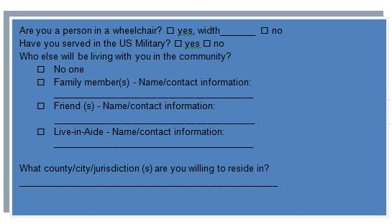
IHI-Household Information
Where would you like to live? Do you have a specific neighborhood that you want to live in or want to avoid? A specific county or area of the state?
Who would you like to live with? Does this person(s) visit you in the nursing home? Will this person (s) be able to obtain a positive landlord reference?
Do you need a live-in aide?
Are you a person in a wheelchair? What kinds of accessible features are you looking for?

Slide 14
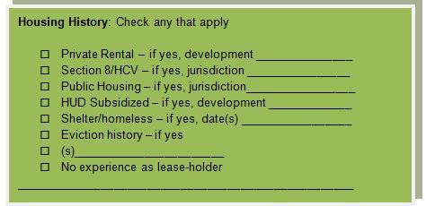
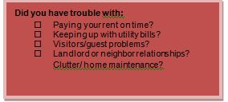
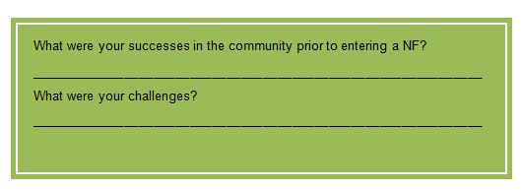
IHI: Housing History
Where did you live in the community before you entered an institution/nursing home? How did your tenancy end?
What living arrangement worked well for you?
Have you ever lived in public housing or had a HCV before? How did that experience work for you? Do you owe any money to a PHA?
Have you ever signed your own lease? Do you have a landlord who can offer you a reference? Have you ever experienced any evictions?

Slide 15
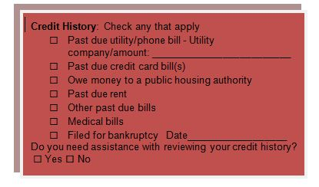
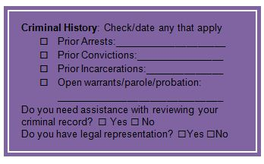
IHI: Credit and Criminal Histories
What kinds of monthly bills did you pay when you were living in the community?
Do you have some bills or accounts that are behind?
Were you able to keep up with your monthly rent payments before entering an institution?
Have you ever applied for a credit card or a loan?
Do you currently have a bank/savings account?

Slide 16
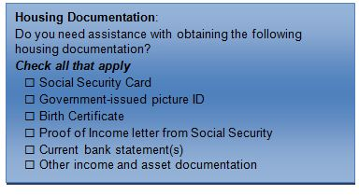
IHI: Housing Documents and Transportation

Slide 17
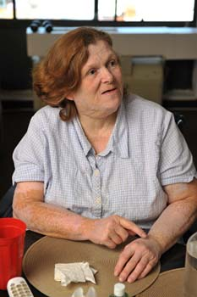
IHI: Community Living Preferences

Slide 18
IHI: Strengths and Challenges

Slide 19
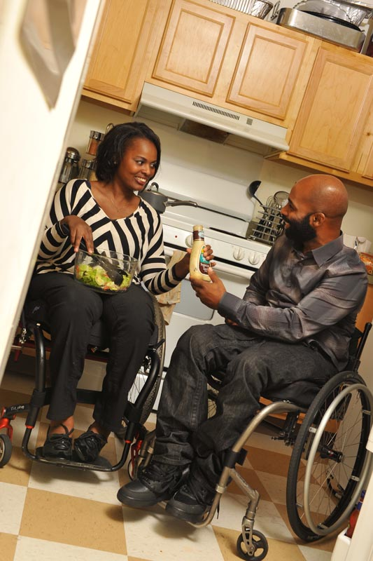
IHI: Housing Options

Slide 20
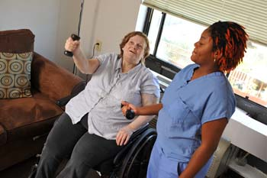
Outcomes of Using a Housing Assessment
Increases chances of accessing an affordable housing program/community housing
Leads to appropriate community housing
Provides more consistent communication and relationship building with service providers
Leads to housing stability/retention
Strengthens partnerships with housing providers

Slide 21
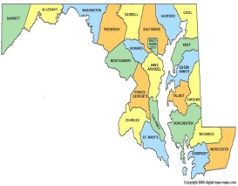
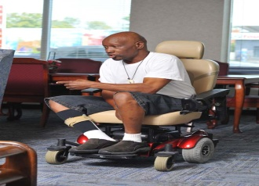
System-Level Advantages of Using a Housing Assessment
Provides system level data:
Number of persons in need of affordable housing that your program serves
Number of persons desiring to live in a particular area
Number of persons requesting wheelchair accessible units
Number of persons requesting a specific bedroom size
Number of persons with barriers to accessing housing
Demographics, personal housing history, income characteristics

Slide 22
Choose, Get, Keep... Integrated Community Housing
http://www.ilru.org/html/publications/training_manuals/Choose-Get-Keep- Integrated-Housing.pdf

Slide 23
Key Internet Resources
Housing Capacity Building Initiative for Community Living Resource Center www.neweditions.net/housing/resource_center.asp
TAC’s Resource Center on Supportive Housing – Related Policy & Programs 811resourcecenter.tacinc.org/policy-programs/related-policy-programs
TAC’s Resource Center for State Human Service Agencies 811resourcecenter.tacinc.org/state-human-service-agencies
CSH’s Public Housing Agencies’ Toolkit for Supportive Housing www.csh.org/phatoolkit
CSH’s Successfully Housing People with Substance Use Issues www2.csh.org/index.cfm?fuseaction=page.viewPage&pageID=593&nodeID=81
TAC web page with links to findings from “Priced Out in 2012”: http://www.tacinc.org/knowledge-resources/priced-out-findings/

